Slide 1
Nanopore Basecalling and Read QC
GRDI-AMR2
Metagenomics Working Group
Marc-Olivier Duceppe
April 22, 2024

Slide 2
Presentation Plan
Why Nanopore?
How to basecall the reads in “super accuracy” mode?
How to assess run / read quality?

Slide 3

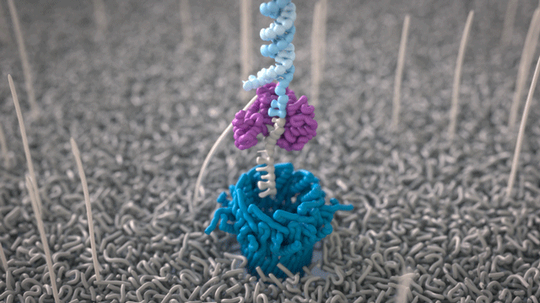
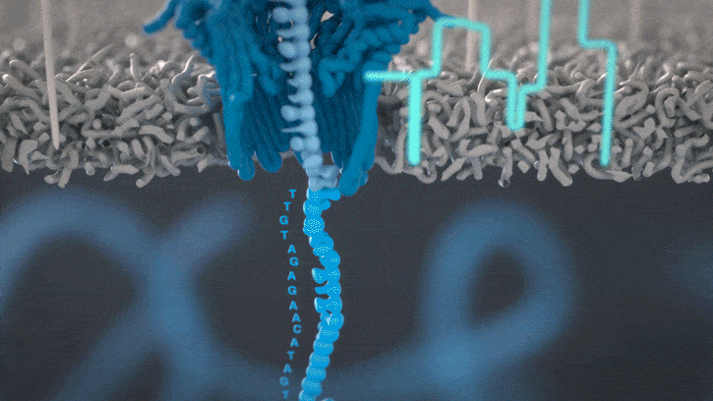
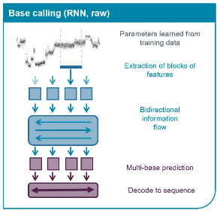
The Nanopore Technology
Basecalling is AI based (Deep Neural Network)
Performed from 5-mers
https://nanoporetech.com/platform/technology/basecalling

Slide 4
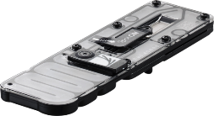
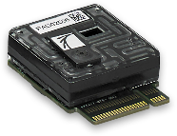
Two Families of Sequencers
MinION Mk1B
Flongle
GridION
Cheaper
PromethION
P2 Solo
P2i
Higher yield and Q-score
https://store.nanoporetech.com/

Slide 5

Do You Believe in Nanopore?
Pros
Cons
$1k / 87g
20bp - 100+kb
Native DNA / RNA
Real-time sequencing
Reusable flowcells
Adaptive sequencing
Growing community
Keeps changing (QA)
Error-prone
Hard to analyze
Computationally intensive (GPU)
Somewhat specialized tools

Slide 6
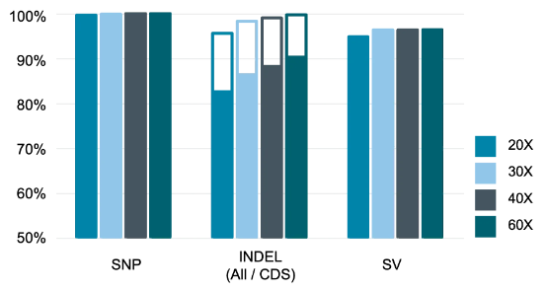


Accuracy
Can’t quite resolve with accuracy long homopolymers stretches
Leads to lots of INDELs
Often long with more errors is better than short with less errors
AMR SNP-based:
AMR functional gene:

Slide 7
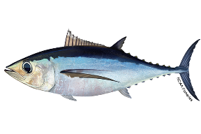
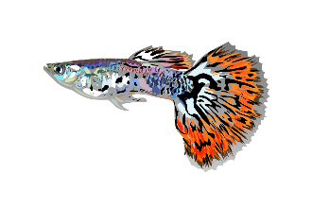

Evolution of Basecallers
Albacore: 2017 – 2018
Guppy: 2018 – 2023
Dorado: 2023 – present
Wick RR, Judd LM, Holt KE. Performance of neural network basecalling tools for Oxford Nanopore sequencing. Genome Biol. 2019 Jun 24;20(1):129. doi: 10.1186/s13059-019-1727-y. PMID: 31234903; PMCID: PMC6591954.

Slide 8
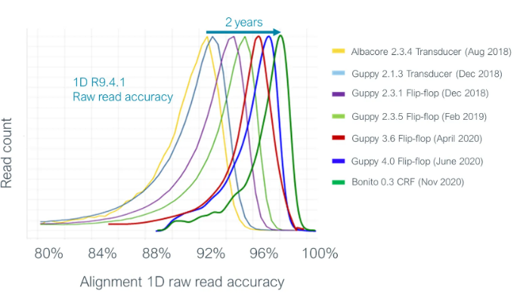
Read Accuracy Keeps Improving
In 2024
R10.4.1 v14
Dorado v0.6
Super accuracy mode
Simplex: 99.5% (Q23)
Duplex: >99.9% (Q30)
More Q15 – Q20
https://nanoporetech.com/platform/accuracy

Slide 9

To Guppy or not to Guppy
Why you’d still want to use Guppy
Don’t know how to run Dorado
You have an easier way to run Guppy
Part of your current SOP / certified workflow
Downstream analysis requirements
“Old” tools with “old” data (e.g. base modification)
Lower end GPU (< 8GB VRAM)
Why you don’t want to use Guppy anymore
Legacy (no more updates)
Slower
Less accurate
New chemistries won’t be supported

Slide 10



Basecalling Recommendations
While sequencing: “Fast” mode
Enables more real-time run metrics
Do not overload host computer
Post sequencing: “Super accuracy” mode
Higher Q-scores
Less “fail” reads
Better barcode assignment
Need computer with high-end GPU
Loose real-time benefit

Slide 11


Guppy - Legacy
Input: Fast5 and kits (“final_summary”)
Output: Fastq and “sequencing_summary”
https://cdn.oxfordnanoportal.com/software/analysis/ont-guppy_6.5.7_linux64.tar.gz
https://github.com/duceppemo/basecall_nanopore

Slide 12

Dorado – Two Flavours
Standalone
Input: Pod5 | Fast5
Output: a single uBAM | SAM | Fastq
Needs to be demultiplexed separately
Fastq headers only contain “ReadID“
https://github.com/nanoporetech/dorado (v0.6.0)

Slide 13

Dorado – Two Flavours
Basecall Server
Input: Pod5 | Fast5
Output: Fastq and “sequencing_summary.txt”
Demultiplexing built in
Fastq headers with “all” info (like Guppy)
https://cdn.oxfordnanoportal.com/software/analysis/ont-dorado-server_7.3.9_linux64.tar.gz

Slide 14

Nanopore read QC
pycoQC v2 (https://github.com/a-slide/pycoQC)
Designed for Guppy
Can work with Dorado
Standalone: need to run additional commands to generate a compatible "seq_summaray.txt" file
Server: as is

Slide 15

Added Features
pycoQC v3 (https://github.com/duceppemo/pycoQC)
Work in progress
Designed to accept all dorado output file types
Additional scripts:
Pod5_to_seq_summary (no basecall information)
Bam_to_seq_summary (slow)
Fastq_to_seq_summary (recommended)
Starting from Fastq triggers additional GC plots
Display “All”, “Pass” or “Fail” reads

Slide 16
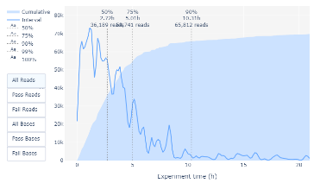
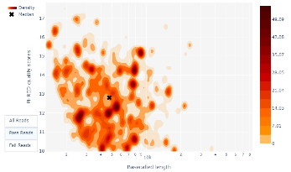
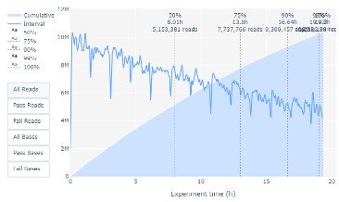
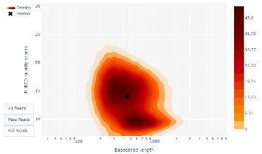
Suboptimal Loading
High quality library
Not enough loaded
Ran out after 10h
High quality library
Run stopped too early

Slide 17
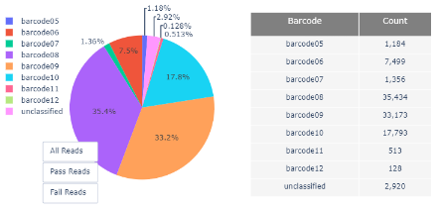
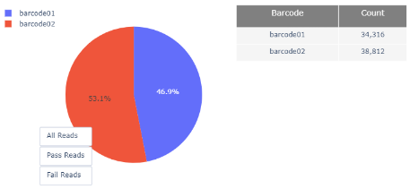
Suboptimal Sample Normalization
Uneven barcode distribution
Poor normalization
Adapter ligation problems
Wrong molarity
Equal barcode distribution
MinKNOW now uses adaptive sequencing to help balance barcodes

Slide 18
Run Diagnosis
Very useful to find what went wrong
DNA extraction (contaminants, short DNA fragments, etc.)
Library prep (adapter-to-DNA ratio, sample normalization, etc.)
Sequencing (flowcell quality, amount loaded, overheating, script error, etc.)

Slide 19
You Can Do It!
Github repo with basic code to install and run Dorado basecall server
https://github.com/OLF-Bioinformatics/2024-04-22_GRDI_basecalling_presentation

Slide 20
Nanopore Metagenomics Resources
https://github.com/duceppemo/mashID
Quick species ID from metagenomics samples
Raw reads or assemblies
Pre-compiled DB available for bacteria
https://github.com/duceppemo/seqcounter
Ultra-rapid preliminary AMR detection from raw reads

Slide 21


Take-Home Message
Switch to Dorado!
Why basecall you runs using Dorado SUP?
Access higher accuracy
It keeps getting better (chemistry and software)
Better downstream analysis results
DNA quality (and its size) matters
Garbage in = garbage out
The longer the better
Amplified DNA sequences better (number of reads and q-score)
Bioinformaticians are not magicians
Bad runs need to be scraped (like for diagnostics)
The truth is in the reads
Read QC will help you find what went wrong and areas of improvement

Slide 22
Thank You!
Q & A

